Slide 1
Algorithms
Lecture 1.2-2.1
Dr. Md Moniruzzaman

Slide 2
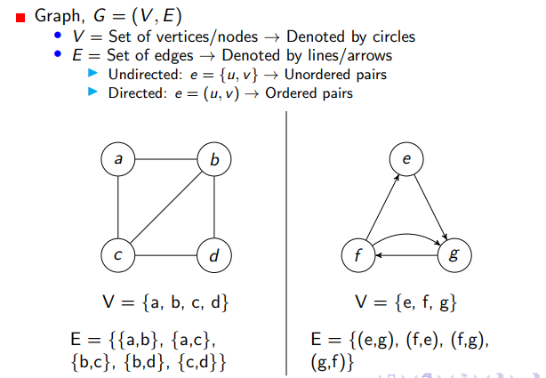
Graph

Slide 3
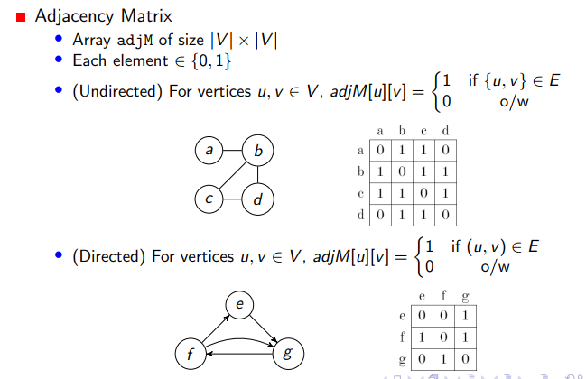
Adjacency Matrix

Slide 4
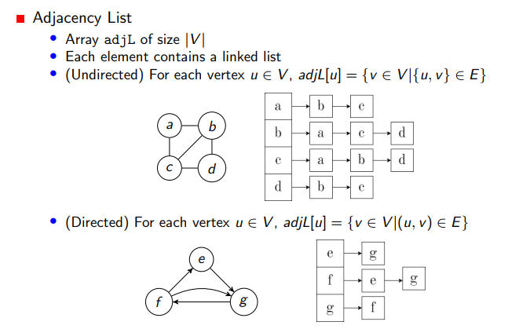
Adjacency List

Slide 5
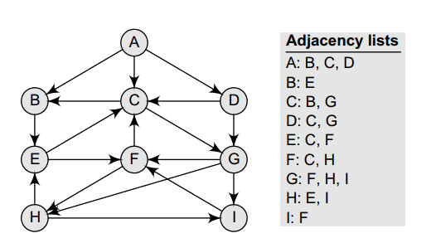
Sample directed graph

Slide 6
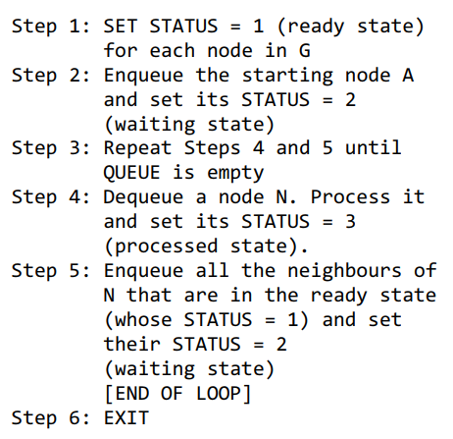
BFS (with 3 states)

Slide 7
BFS (with 2 states)
Initialize a visited array by marking every vertex as not-visited
Declare a queue and insert the starting vertex.
Mark the starting vertex as visited.
Follow the below process till the queue becomes empty:
Remove the first vertex of the queue.
Insert all the unvisited neighbors of the vertex into the queue and mark those vertices as visited.

Slide 8
Implementation
Using vector to store the graph as adjacency list:
vector<int> lst[MAX]; //this is an array of vectors
To insert an element: lst[index].push_back(value);
To get the size of the vector: int sz = lst[index].size();
To maintain a Queue:
queue<int> Q;
To insert an element: Q.push(node);
To retrieve the front element: container = Q.front();
To remove an element : Q.pop();
To check whether empty or not: Q.empty();
Notes:
(1+k1)+(1+k2)+(1+k3)+(1+k4)+…+(1+kn) (1+1+…+1) + (k1+k2+…kn) V+E

Slide 9
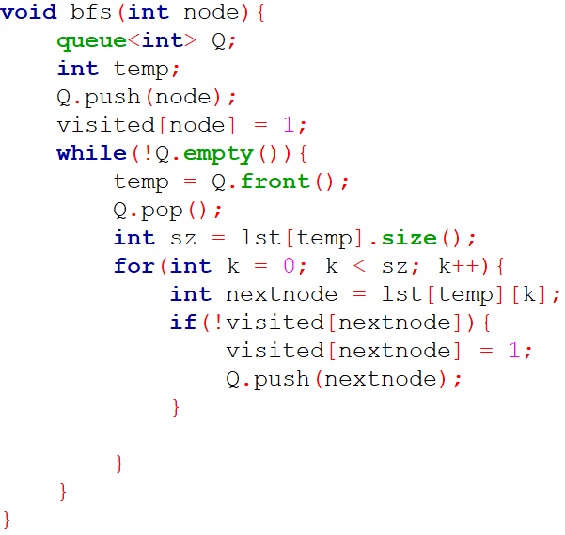
Adjacency List Implementation

Slide 10
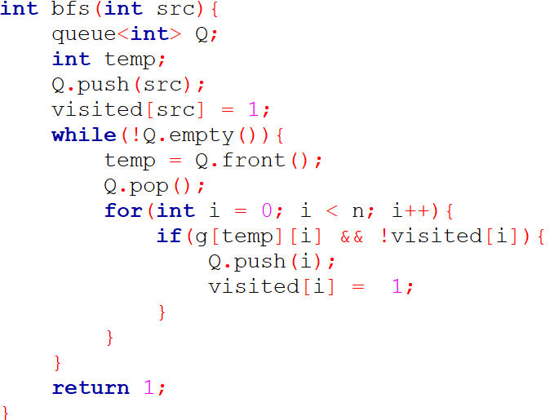
Adjacency Matrix Implementation

Slide 11
DFS (with 2 states)
Initialize a visited array by marking every vertex as not-visited
Declare a stack and insert the starting vertex.
Mark the starting vertex as visited.
Follow the below process till the stack becomes empty:
Remove the first vertex of the stack.
Insert all the unvisited neighbors of the vertex into the stack and mark those vertices as visited.

Slide 12
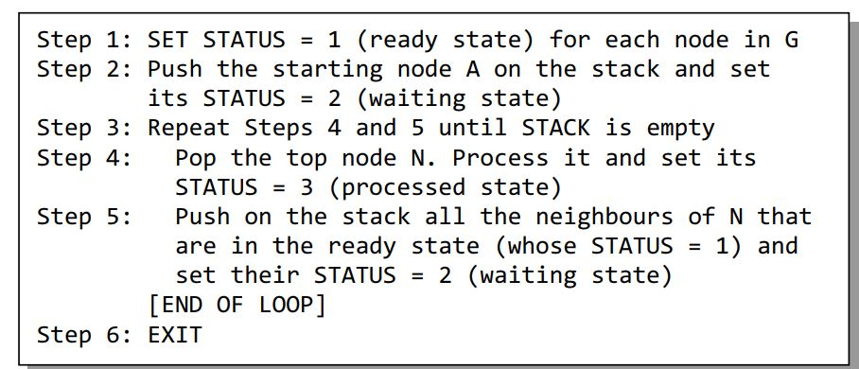
DFS (Continue…)

Slide 13
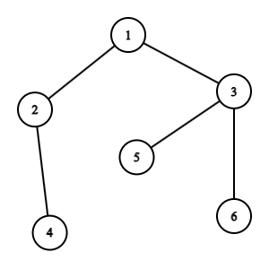
Graph to traverse
Notes:
BFS: 1 2 3 4 5 6 DFS: 1 3 6 5 2 4

Slide 14
Problem
Equalizing Money (Lightoj)
https://lightoj.com/problem/equalizing-money
Building Roads (CSES)
https://cses.fi/problemset/task/1666/

